Slide 1

PROJECT REPORT ON
“STOCKWISE – Inventory Management System”
Subject: Data Structures - Lab Submitted By:
Name | Branch | PRN
Erragunta Aapti Reddy | CSE | 25070721018
Yennam Krithika Reddy | CSE | 25070721062

Slide 2
INDEX
Acknowledgement
Abstract and Introduction
Methodology
Data Structures and Algorithms Used
Applications and Future Scope

Slide 3
ACKNOWLEDGEMENT
We take this opportunity to express our heartfelt gratitude to everyone who has guided and supported us throughout the completion of our project titled “STOCKWISE – INVENTORY MANAGEMENT SYSTEM”
First and foremost, we extend our deepest thanks to Dr. Rakesh Salakapuri, our professor and project guide, for his constant encouragement, valuable guidance, and continuous support. His insightful feedback and in-depth knowledge helped us understand the technical intricacies of microcontroller-based systems and bring our concept to life as a fully functional prototype. His mentorship has been a constant source of inspiration throughout this journey.
We would like to express our sincere gratitude to Dr. Rajinikanth Aluvalu, Director of Symbiosis Institute of Technology, Hyderabad, for providing us with the necessary infrastructure, resources, and an environment that encourages innovation, experimentation, and research. His vision for academic excellence has motivated us to pursue this project with dedication and creativity.
Finally, we would like to express our gratitude to our peers and classmates for their helpful suggestions, cooperation, and moral support throughout the project. We are also thankful to Symbiosis Institute of Technology, Hyderabad, for providing us with the platform and resources to transform our ideas into reality.

Slide 4
ABSTRACT AND INTRODUCTION
StockWise is a browser-based inventory management system developed to simplify the process of maintaining and monitoring product information. It allows users to add, update, delete, search, and sort product records efficiently.
The system uses different data structures and algorithms, such as Binary Search Trees, Linear Search, Binary Search, and Merge Sort, to perform inventory operations.
It also provides a dashboard that displays important information, including total products, available stock, inventory value, and low-stock or out-of-stock products.
Inventory management is the process of tracking products, quantities, and prices maintained by an organization.
Traditional inventory management using notebooks or spreadsheets can make it difficult to locate products, update records, and identify products that need restocking.
StockWise provides a simple digital solution that helps users manage inventory in an organized manner.
Main features:
Digital product record management.
Quick product searching.
Sorting products based on different attributes.
Monitoring stock availability.
Displaying inventory statistics.

Slide 5
METHODOLOGY
System Development Methodology
User Login: The user enters login credentials to access the application.
Dashboard Display: The system displays inventory statistics and stock information.
Product Management: Users can add new products, edit existing records, and delete unwanted products.
Data Processing: Product information is processed using searching and sorting algorithms.
BST Implementation: Product SKUs are used to construct a Binary Search Tree.
Stock Monitoring: The system identifies low-stock and out-of-stock products.
Data Storage: Inventory information is stored in browser Local Storage so that it remains available after refreshing the page.
System Modules
1. Login Module
Provides an administrator login interface.
Allows access to the inventory dashboard
Dashboard Module
  Displays total products.
  Shows total units in stock.

Slide 6
Calculates inventory value.
Displays low-stock and out-of-stock products.
Inventory Management Module
  Add new products.
  Edit product details.
  Delete products.
  Search products by name, category, or SKU.
  Sort products by name, SKU, quantity, or price.
  Export inventory records as a CSV file

Slide 7
DATA STRUCTURES AND ALGORITHMS USED
Binary Search Tree (BST)
A Binary Search Tree is a hierarchical data structure in which:
  The left subtree contains smaller values.
  The right subtree contains greater values.
  Each node represents a product SKU.
In StockWise, numeric product SKUs are used as BST values.
BST Traversals :-
Inorder: Left → Root → Right.
Preorder: Root → Left → Right.
Inorder traversal of a BST displays the values in ascending order.
Linear Search
  Checks products one by one.
  Used for searching by product name or category.
  Does not require sorted data.
  Time complexity: O(n).

Slide 8
Binary Search
  Searches for a product using its numeric SKU.
  Repeatedly divides the sorted search range into two halves.
  Requires sorted data.
  Time complexity: O(log n).
Merge Sort
  Uses the divide-and-conquer technique.
  Divides the product list into smaller sections.
  Sorts each section.
  Merges the sorted sections into one sorted list.
  Time complexity: O(n log n).

Slide 9
APPLICATIONS AND FUTURE SCOPE
Applications
Retail Stores: Managing products, prices, and available stock.
Supermarkets: Maintaining product records and identifying products with low stock.
Warehouses: Organizing large numbers of product records.
Stationery Shops: Tracking notebooks, pens, and other stationery products.
Small Businesses: Maintaining basic inventory information digitally.
Future Scope
  Database integration using MySQL or MongoDB.
  Multiple user accounts and role-based access.
  Barcode and QR-code scanning.
  Supplier and purchase management.
  Automatic low-stock notifications.
  Inventory reports and graphical charts.
  Cloud-based storage and access.

Slide 10
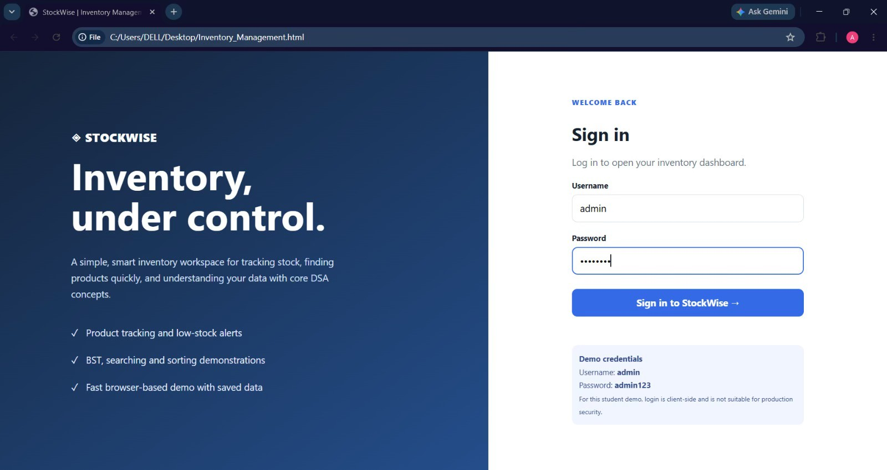
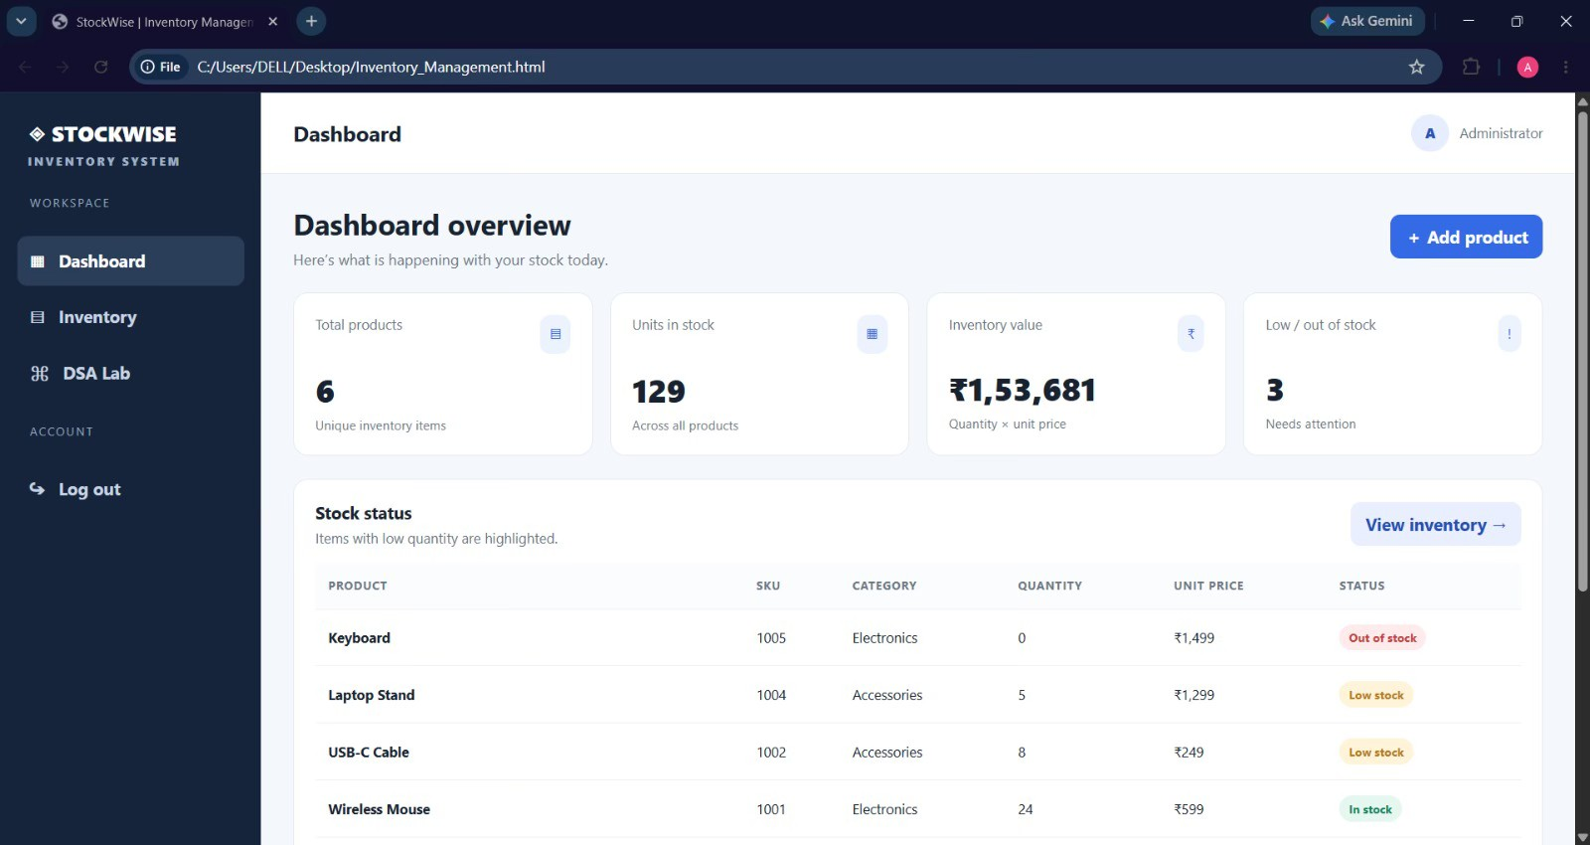
(this is a basic prototype of the website)
(It is the login page of the website)
(It gives access to the inventory dashboard)
(this is the Dashboard page of the website)

Slide 11
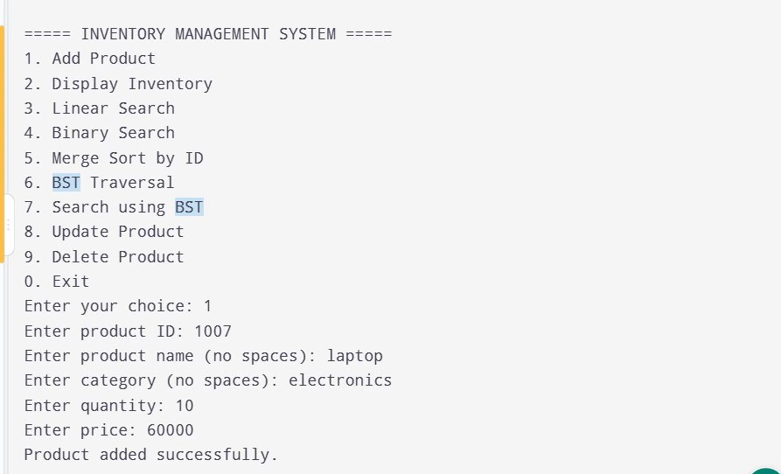
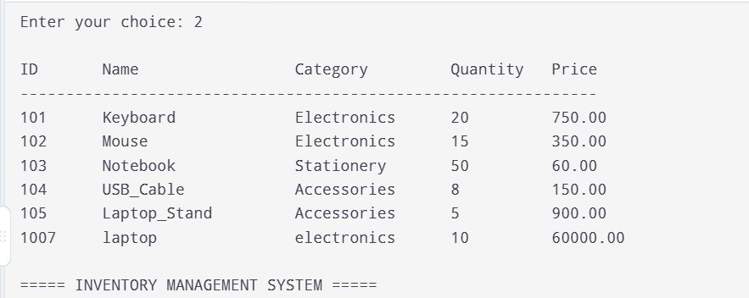
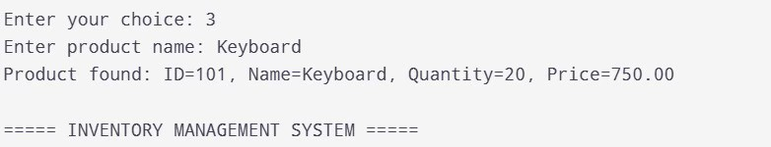
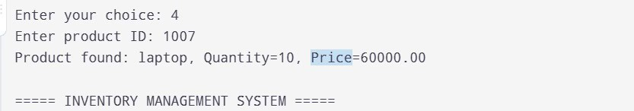
(OUTPUTS :- Add Products)
(Display Inventory)
(Linear and Binary Search)

Slide 12
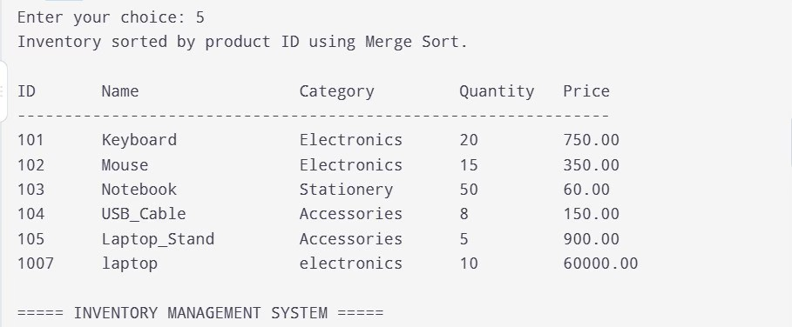
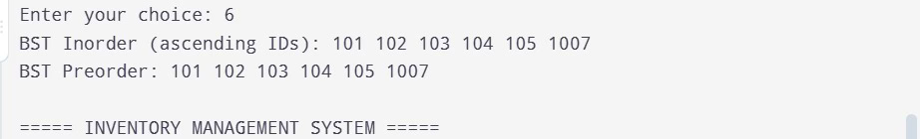
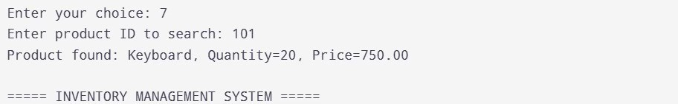
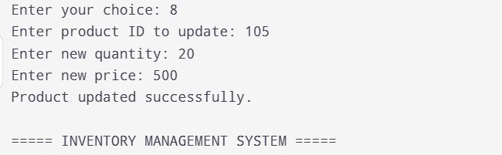
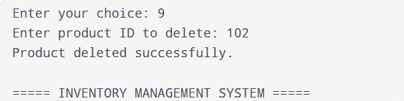
(Merge Sort by id)
(BST Traversal)
(Search by BST)
(Update of Product)
(Deletion of product)

Slide 13
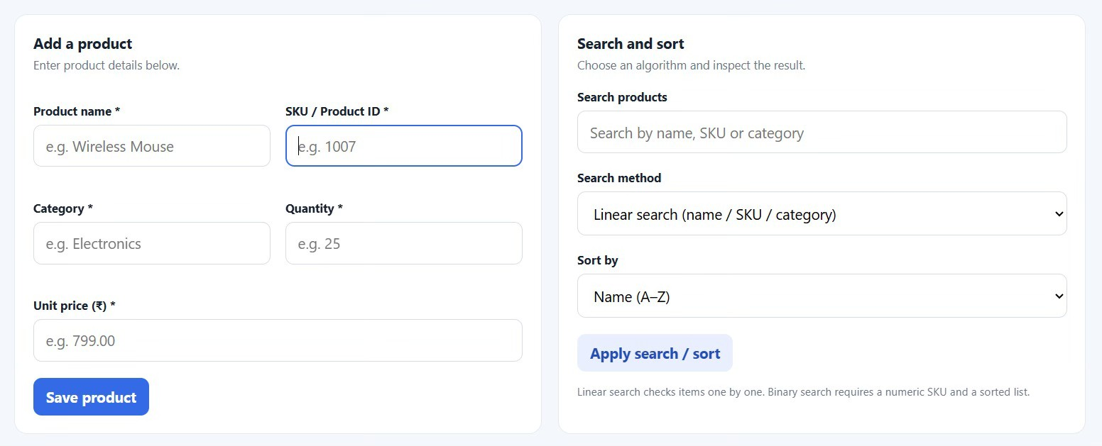
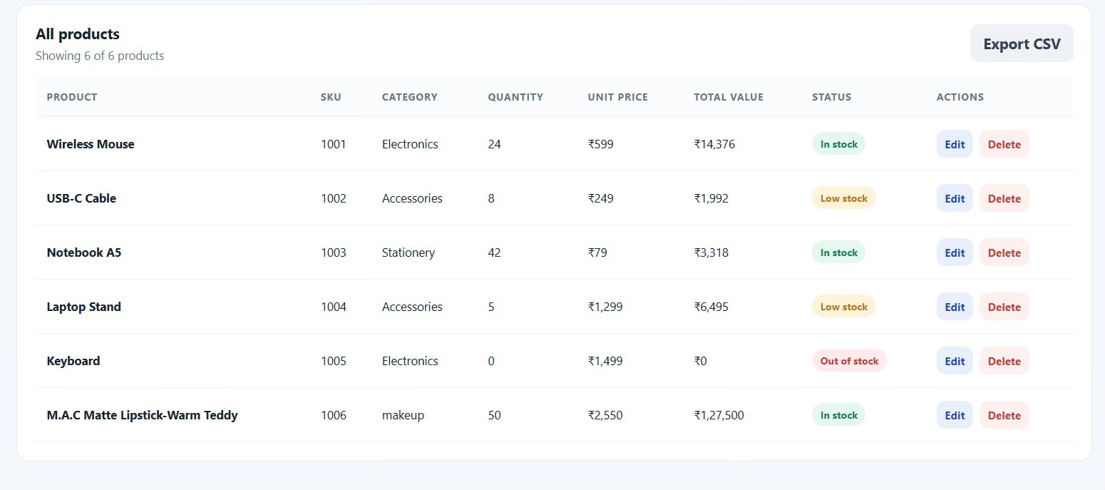
(Add Search and Sort products)
(Updated data of all products)

